Slide 1
CUA REU Week 3
Antonio Perillo

Slide 2
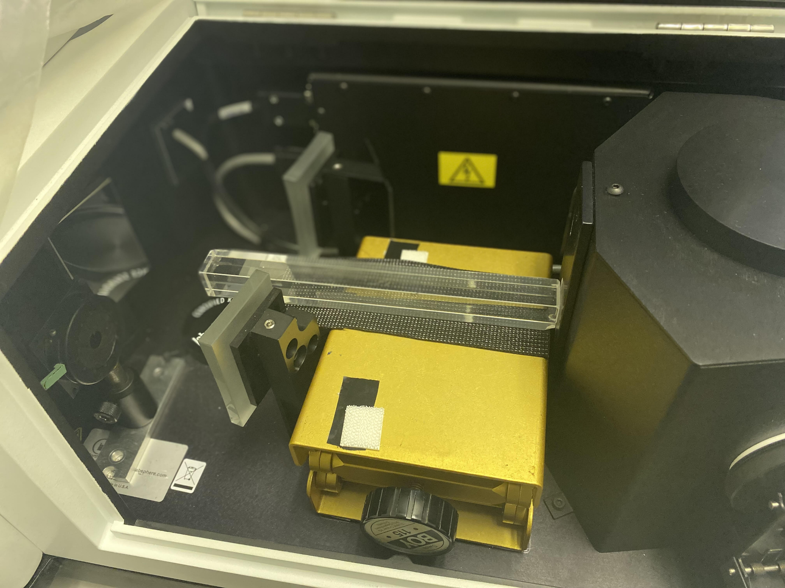
Transmittance Experiments

Slide 3
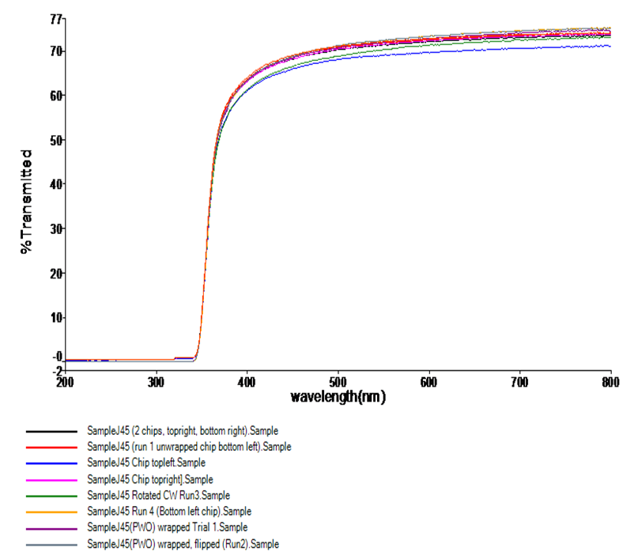
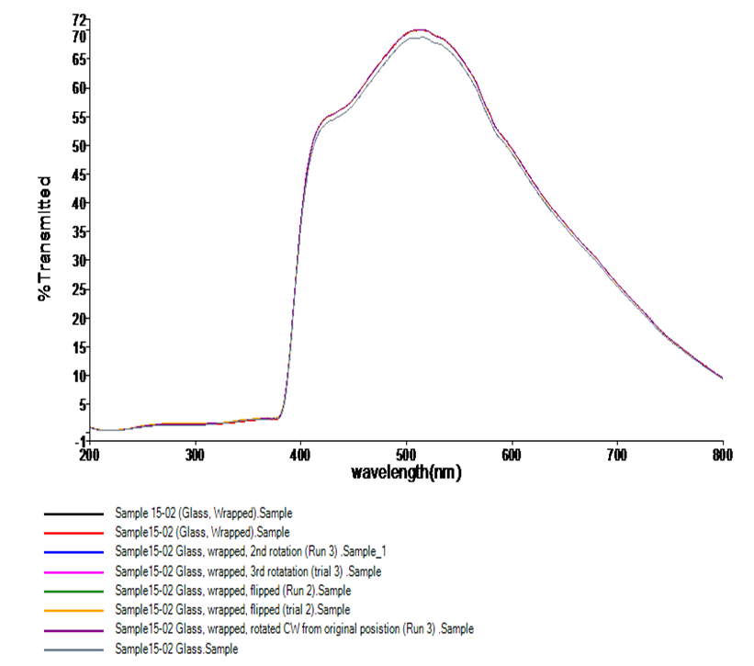
Lead Tungstate Crystal
Glass Scintillator

Slide 4
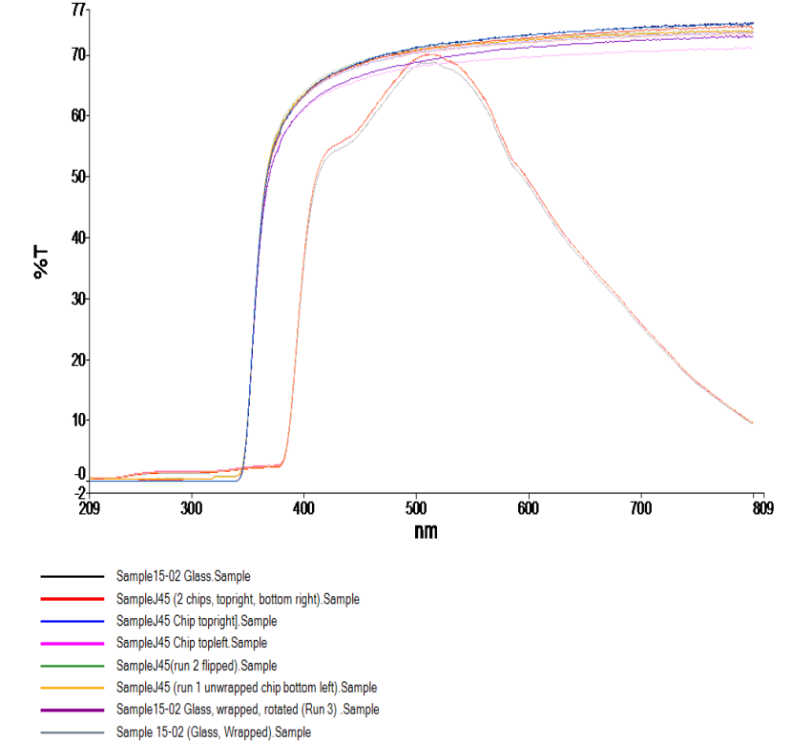
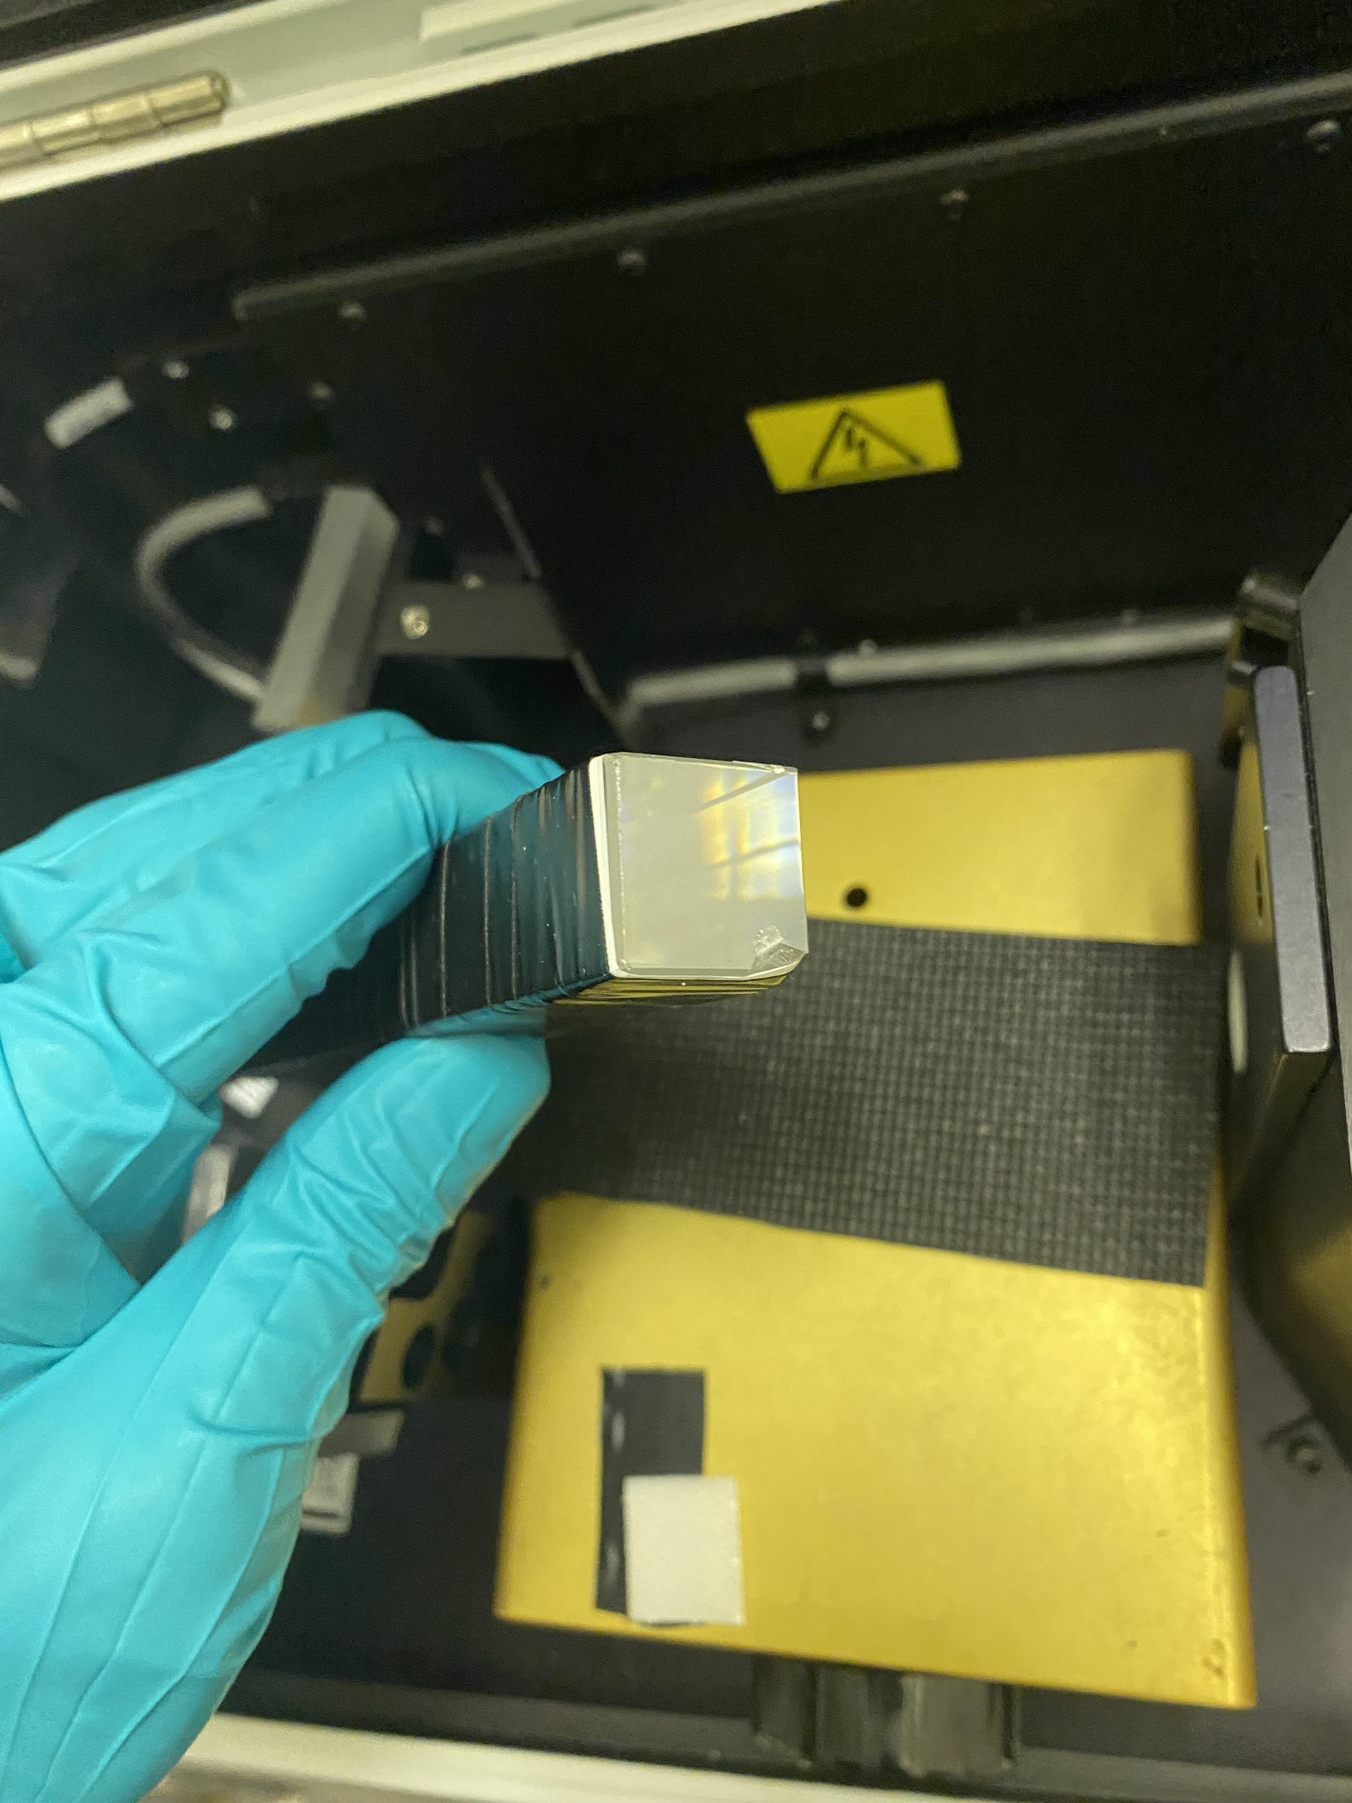

Slide 5
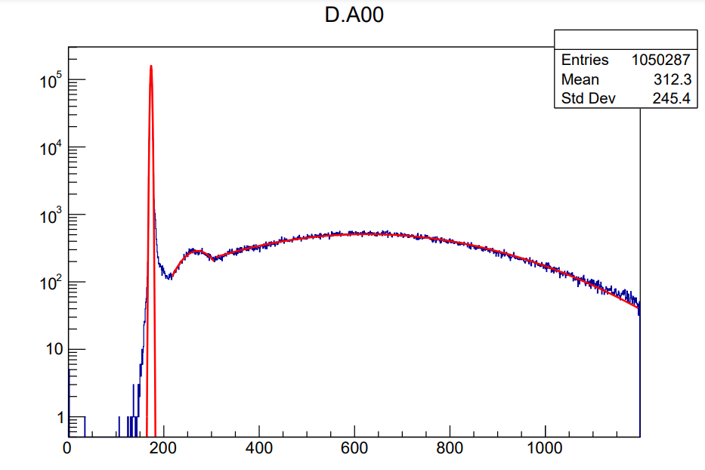
Experimental Light Yield Results
J24: LY ~ 9.07 pe/MeV

Slide 6
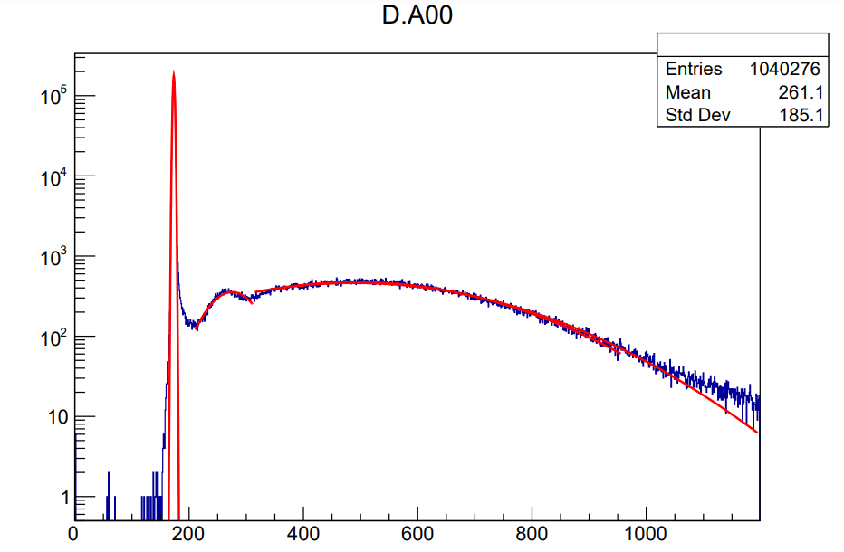
J24
LY ~ 6.06 pe/MeV

Slide 7
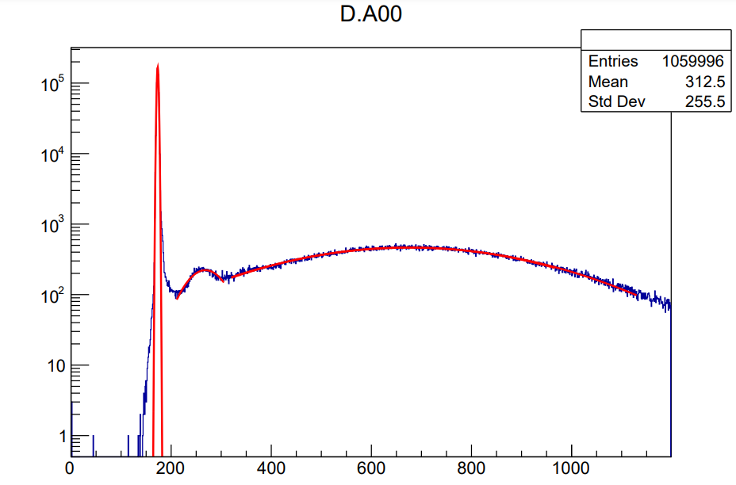
J39
LY: ~ 10.36 pe/MeV

Slide 8
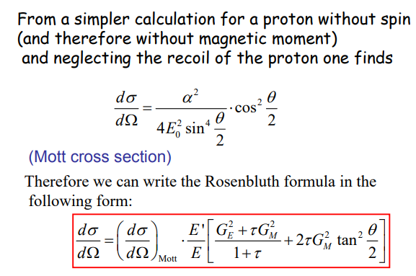
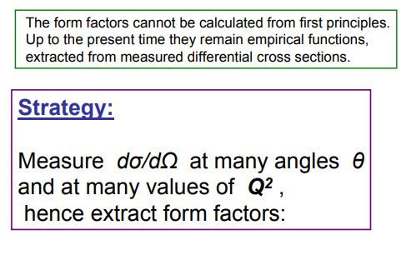
Computation

Slide 9
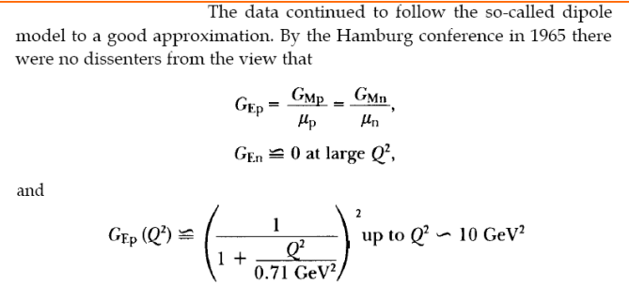
The Dipole Model

Slide 10
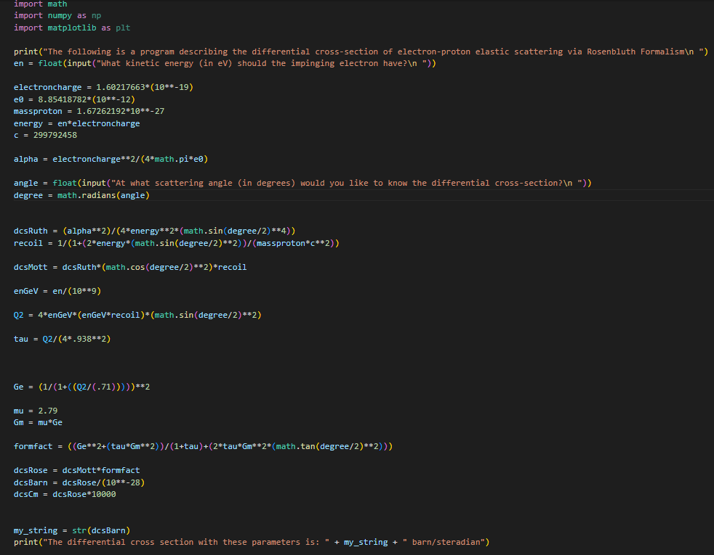

Slide 11
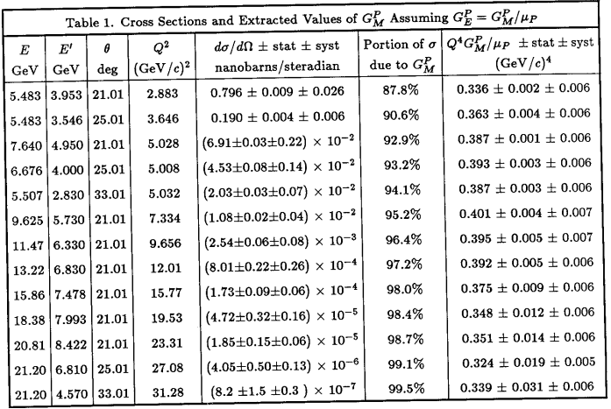
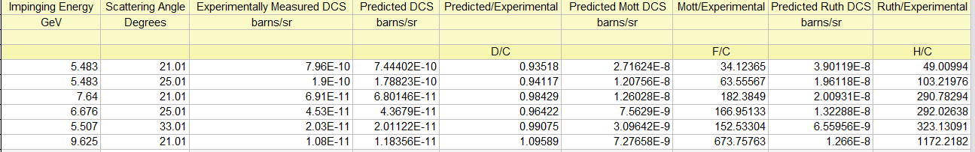
Results from SLAC experiment
Table summarizing my predicted values of the DCS using Rosenbluth, Mott, and Rutherford formalisms

